Slide 1

Lecture 11: Object Oriented Modelling
University of Toronto
Department of Computer Science
➲ Object Oriented Analysis
 Rationale
 Identifying Classes
 Attributes and Operations
➲ UML Class Diagrams
 Associations
 Multiplicity
 Aggregation
 Composition
 Generalization

Slide 2
Requirements & Domain Models
University of Toronto
Department of Computer Science
Reminder: we are modeling this and this … … … … but not this
Application Domain
D - domain properties R - requirements
Machine Domain
C - computers P - programs
➲ Our analysis models should…
 …represent people, physical things and concepts important to our understanding of what is going on in the application domain
 …show connections and interactions among these people, things and concepts.
 …show the business situation in enough detail to evaluate possible designs.
 …be organized to be useful later, during design and implementation of the software.
 …allow us to check whether the functions we will include in the specification will satisfy the requirements
 …test our understanding of how the new system will interact with the world

Slide 3
Object Oriented Analysis
University of Toronto
Department of Computer Science
➲ Background
 Model the requirements in terms of objects and the services they provide
 Grew out of object oriented design
Applied to modelling the application domain rather than the program
➲ Motivation
 OO is (claimed to be) more ‘natural’
As a system evolves, the functions it performs need to be changed more often than the objects on which they operate…
…a model based on objects (rather than functions) will be more stable over time…
…hence the claim that object-oriented designs are more maintainable
 OO emphasizes importance of well-defined interfaces between objects
compared to ambiguities of dataflow relationships
NOTE: OO applies to requirements engineering because it is a modeling tool. But we are modeling domain objects, not the design of the new system

Slide 4
Nearly anything can be an object…
University of Toronto
Department of Computer Science
Source: Adapted from Pressman, 1994, p242
➲ External Entities
 …that interact with the system being modeled
E.g. people, devices, other systems
➲ Things
 …that are part of the domain being modeled
E.g. reports, displays, signals, etc.
➲ Occurrences or Events
 …that occur in the context of the system
E.g. transfer of resources, a control action, etc.
➲ Roles
 played by people who interact with the system
➲ Organizational Units
 that are relevant to the application
E.g. division, group, team, etc.
➲ Places
 …that establish the context of the problem being modeled
E.g. manufacturing floor, loading dock, etc.
➲ Structures
 that define a class or assembly of objects
E.g. sensors, four-wheeled vehicles, computers, etc.
Some things cannot be objects:
 procedures (e.g. print, invert, etc)
 attributes (e.g. blue, 50Mb, etc)

Slide 5
What are classes?
University of Toronto
Department of Computer Science
➲ A class describes a group of objects with
 similar properties (attributes),
 common behaviour (operations),
 common relationships to other objects,
 and common meaning (“semantics”).
➲ Examples
 employee: has a name, employee# and department; an employee is hired, and fired;an employee works in one or more projects
:employee
Attributes (optional)
name employee#
Name (mandatory)
department
hire()
fire() assignproject()
Operations (optional)

Slide 6
Finding Classes
University of Toronto
Department of Computer Science
➲ Finding classes from source data:
 Look for nouns and noun phrases in stakeholders’ descriptions of the problem
include in the model if they explain the nature or structure of information in the application.
➲ Finding classes from other sources:
 Reviewing background information;
 Users and other stakeholders;
 Analysis patterns;
➲ It’s better to include many candidate classes at first
 You can always eliminate them later if they turn out not to be useful
 Explicitly deciding to discard classes is better than just not thinking about them

Slide 7
Selecting Classes
University of Toronto
Department of Computer Science
➲ Discard classes for concepts which:
 Are beyond the scope of the analysis;
 Refer to the system as a whole;
 Duplicate other classes;
 Are too vague or too specific
e.g. have too many or too few instances
 Coad & Yourdon’s criteria:
Retained information: Will the system need to remember information about this class of objects?
Needed Services: Do objects in this class have identifiable operations that change the values of their attributes?
Multiple Attributes: If the class only has one attribute, it may be better represented as an attribute of another class
Common Attributes: Does the class have attributes that are shared with all instances of its objects?
Common Operations: Does the class have operations that are shared with all instances of its objects?
 External entities that produce or consume information essential to the system should be included as classes

Slide 8
Objects vs. Classes
University of Toronto
Department of Computer Science
➲ The instances of a class are called objects.
 Objects are represented as:
Fred_Bloggs:Employee
name: Fred Bloggs Employee #: 234609234 Department: Marketing
 Two different objects may have identical attribute values (like two people with identical name and address)
➲ Objects have associations with other objects
 E.g. Fred_Bloggs:employee is associated with the KillerApp:project object
 But we will capture these relationships at the class level (why?)
 Note: Make sure attributes are associated with the right class
E.g. you don’t want both managerName and manager# as attributes of Project! (…Why??)

Slide 9
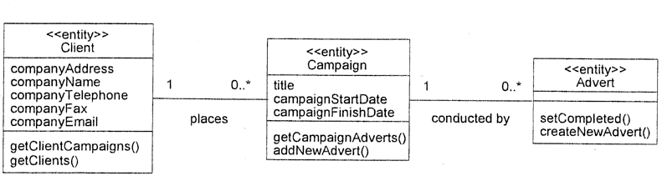
Associations
University of Toronto
Department of Computer Science
➲ Objects do not exist in isolation from one another
 A relationship represents a connection among things.
 In UML, there are different types of relationships:
Association
Aggregation and Composition
Generalization
Dependency
Realization
 Note: The last two are not useful during requirements analysis
➲ Class diagrams show classes and their relationships

Slide 10
Association Multiplicity
University of Toronto
Department of Computer Science
➲ Ask questions about the associations:
 Can a campaign exist without a member of staff to manage it?
If yes, then the association is optional at the Staff end - zero or more (0..*)
If no, then it is not optional - one or more (1..*)
If it must be managed by one and only one member of staff - exactly one (1)
 What about the other end of the association?
Does every member of staff have to manage exactly one campaign?
No. So the correct multiplicity is zero or more.
➲ Some examples of specifying multiplicity:
 Optional (0 or 1) 0..1
 Exactly one | 1 | = 1..1
 Zero or more | 0..* | = *
 One or more | 1..*
 A range of values | 2..6

Slide 11
University of Toronto
Department of Computer Science
Class associations
Multiplicity
Multiplicity
A client has
A staff member has zero or more clients on His/her clientList
exactly one staffmember as a contact person
Name of the
association
:Client
:StaffMember
companyAddress companyEmail companyFax companyName companyTelephone
staffName staff# staffStartDate
1
liaises with
0..*
contact person
ClientList
Direction The “liaises with”
association should be
_{Role} read in this direction
The staffmember’s role in this association is as a contact person
Role
The clients’ role in this association is as a clientList

Slide 12
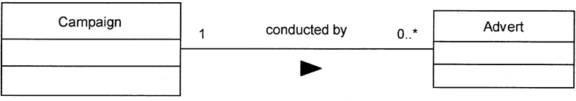
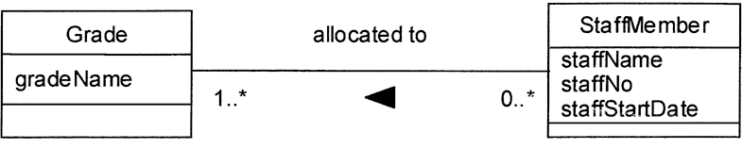
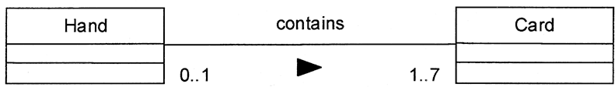
More Examples
University of Toronto
Department of Computer Science

Slide 13
Association Classes
University of Toronto
Department of Computer Science
➲ Sometimes the association is itself a class
 …because we need to retain information about the association
 …and that information doesn’t naturally live in the classes at the ends of the association
E.g. a “title” is an object that represents information about the relationship between an owner and her car
:person
:car
Name Address
DriversLicenceNumber
PermittedVehicles
VIN(vehicle Id Number) YearMade
Mileage
0..*
owns
1
owner
:title
yearbought initialMileage PricePaid LicencePlate#

Slide 14
Aggregation and Composition
University of Toronto
Department of Computer Science
➲ Aggregation
 This is the “Has-a” or “Whole/part” relationship
➲ Composition
 Strong form of aggregation that implies ownership:
if the whole is removed from the model, so is the part.
the whole is responsible for the disposition of its parts
1
:Engine
composition
1
:Locomotive | 1..*
 |  | 0..1
:Car
:Train
0..1
:Person
0..*
0..1
aggregation
driver 1
passengers

Slide 15
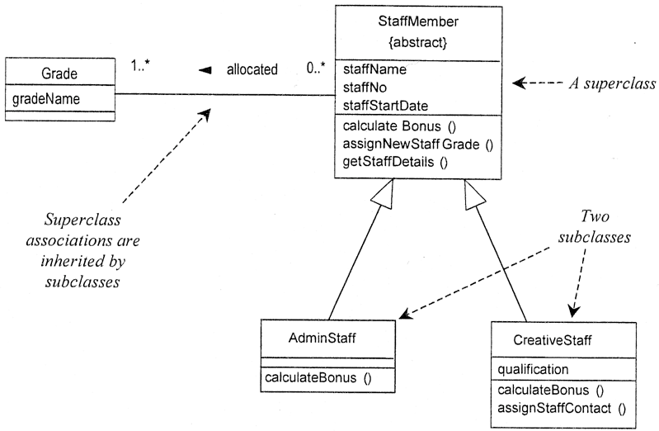
Generalization
University of Toronto
Department of Computer Science
➲ Notes:
 Subclasses inherit attributes, associations, & operations from the superclass
 A subclass may override an inherited aspect
e.g. AdminStaff & CreativeStaff have different methods for calculating bonuses
 Superclasses may be declared {abstract}, meaning they have no instances
Implies that the subclasses cover all possibilities
e.g. there are no other staff than AdminStaff and CreativeStaff

Slide 16
More on Generalization
University of Toronto
Department of Computer Science
➲ Usefulness of generalization
 Can easily add new subclasses if the organization changes
➲ Look for generalizations in two ways:
 Top Down
You have a class, and discover it can be subdivided
Or you have an association that expresses a “kind of” relationship
E.g. “Most of our work is on advertising for the press, that’s newspapers and magazines, also for advertising hoardings, as well as for videos”
 Bottom Up
You notice similarities between classes you have identified
E.g. “We have books and we have CDs in the collection, but they are all filed using the Dewey system, and they can all be lent out and reserved”
➲ But don’t generalize just for the sake of it
 Be sure that everything about the superclass applies to the subclasses
 Be sure that the superclass is useful as a class in its own right
I.e. not one that we would discard using our tests for useful classes
 Don’t add subclasses or superclasses that are not relevant to your analysis

Slide 17



University of Toronto
Department of Computer Science
Class Diagrams
aggregation
:eye
Class name
Colour Diameter Correction
0..2
:patient
multiplicities
attributes
0..1
:kidney
Name
Date of Birth Height Weight
Operational?
0..1
services
0..1
1..2
 | 1 | :heart
 |  | Normal bpm Blood type
generalization
:In-patient
Room Bed Physician
:Out-patient
Last visit next visit physician
:organ
Natural/artif. Orig/implant donor

Slide 18
Summary
University of Toronto
Department of Computer Science
➲ Understand the objects in the application domain
 Identify all objects that stakeholders refer to
 Decide which objects are important for your analysis
 Class diagrams good for:
Visualizing relationships between domain objects
Exploring business rules and assumptions via multiplicities
Specifying the structure of information to be (eventually) stored
➲ OO is a good way to explore details of the problem
 Avoids the fragmentary nature of structured analysis
 provides a coherent way of understanding the world
➲ But beware…
 temptation to do design rather than problem analysis
In RE, class diagrams DO NOT represent programming (e.g. Java) classes
 For analysis, use UML diagrams as sketches, not as blueprints
But may become blueprints when used in a specification

